Slide 1

Logistic Regression
By:
Dr. G G Md Nawaz Ali
E-mail: nali@fsmail.bradley.edu
Slide courtesy:
Dr. Babu K. Baniya
Pierian Data
Ref:
An Introduction to Statistical learning by Gareth James

Slide 2
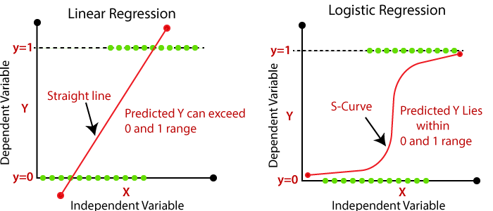
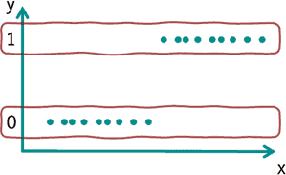
Logistic Regression
Logistic regression is a baseline supervised machine learning algorithm for performing classification task
For binary classification: two variables (0 & 1) can be predicated.
The probability of the occurrence of value 1 (=characteristic present) is estimated.
Logistic Regression

Slide 3
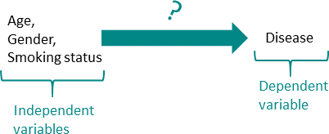
Logistic Regression (Example)
A frequent application is to find out which variables have an influence on a disease.
In this case, 0 could stand for “not disease” and 1 for “disease”.
The influence of age, gender and smoking status (smoker or not) on this disease could be examined.

Slide 4
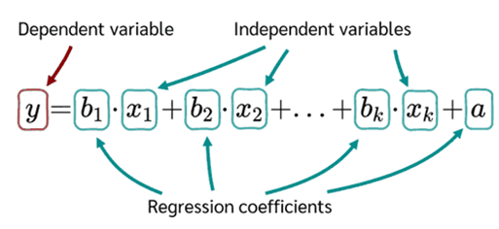
Logistic Regression
Linear regression equation (y=mx+c) #m is slope, c-intercept

Slide 5
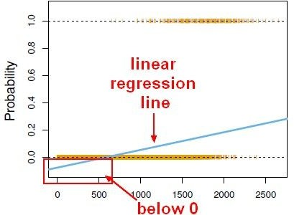
Logistic Regression
We simply cannot use a normal linear regression model on binary groups. It won’t lead to a good fit:

Slide 6
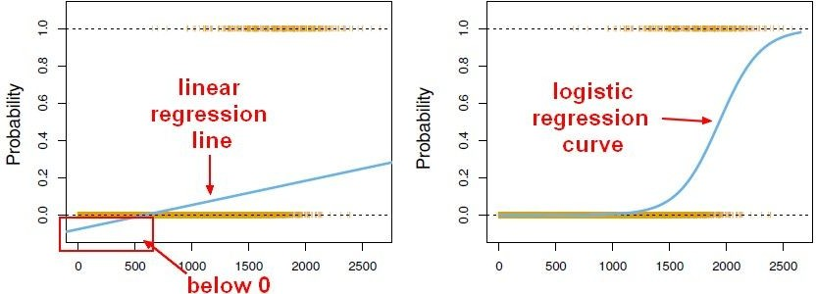
Logistic Regression Cont.
However, we can transform our linear regression to a logistic regression curve.

Slide 7
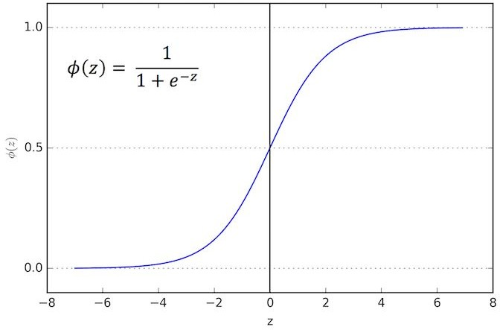
Logistic Regression: Sigmoid function
The Sigmoid (Logistic) function takes in any value and converts it to a value between 0 and 1.

Slide 8
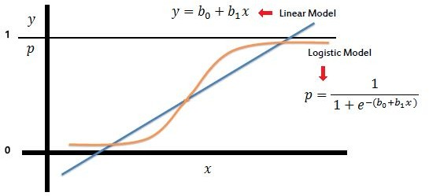
Logistic Regression: Sigmoid Function Cont.
We can take our Linear Regression equation and place it into the Sigmoid Function.

Slide 9
Logistic Regression: Sigmoid Function Cont.
Then, we can set a cutoff point at 0.5, anything below it results in class 0, anything above is class 1.

Slide 10
Example (iris dataset)
sepallength | sepalwidth | petallength | petalwidth | class
5.1 | 3.5 | 1.4 | 0.2 | 0
4.9 | 3 | 1.4 | 0.2 | 0
4.7 | 3.2 | 1.3 | 0.2 | 0
4.6 | 3.1 | 1.5 | 0.2 | 0
5 | 3.6 | 1.4 | 0.2 | 0
5.4 | 3.9 | 1.7 | 0.4 | 0
4.6 | 3.4 | 1.4 | 0.3 | 0
5 | 3.4 | 1.5 | 0.2 | 0
4.4 | 2.9 | 1.4 | 0.2 | 0
4.9 | 3.1 | 1.5 | 0.1 | 1
5.4 | 3.7 | 1.5 | 0.2 | 1
4.8 | 3.4 | 1.6 | 0.2 | 1
Independent Variable
(on the basis of which we want to predict)
Dependent Variable (what we want to predict)

Slide 11
Model Evaluation

Slide 12
Model Evaluation
After you train a logistic regression model on some training data, you want to evaluate your model’s performance on some test data.
You can use a confusion matrix to evaluate classification models.
You can also use some other performance metrices such as Accuracy, Precision, Recall and F1-score

Slide 13
Basic Terminology
True Positive (TP) - test result is one that detects the risk when the risk is present.
True Negative (TN) - test result is one that does not detect the risk when the risk is absent.
False Positive (FP) - test result is one that detects the risk when the risk is absent.
False Negative (FN) - test result is one that does not detect the risk when the risk is present.
True class
Positive
Negative
Positive
TP
FP
type I error
Predicated class
FN
TN
type II error
Negative

Slide 14




Performance Metrices
Precision (also called positive predictive value) is the fraction of relevant instances among the retrieved instances.
$$Precision=\frac{TP}{TP+FP}$$
Goal: to minimize mistakes in guessing positive labels
Recall (also known as sensitivity) is the fraction of relevant instances that were retrieved.
$$Recall=\frac{TP}{TP+FN}$$
Goal: to find a greater number of positive labels and minimize the false negative
F1-Score: A measure that combines precision and recall is the harmonic mean of precision and recall, the traditional F-measure or balanced F-score
$$F=2∗\frac{precision∗recall}{precision+recall}$$
Ref: https://en.wikipedia.org/wiki/Confusion_matrix

Slide 15
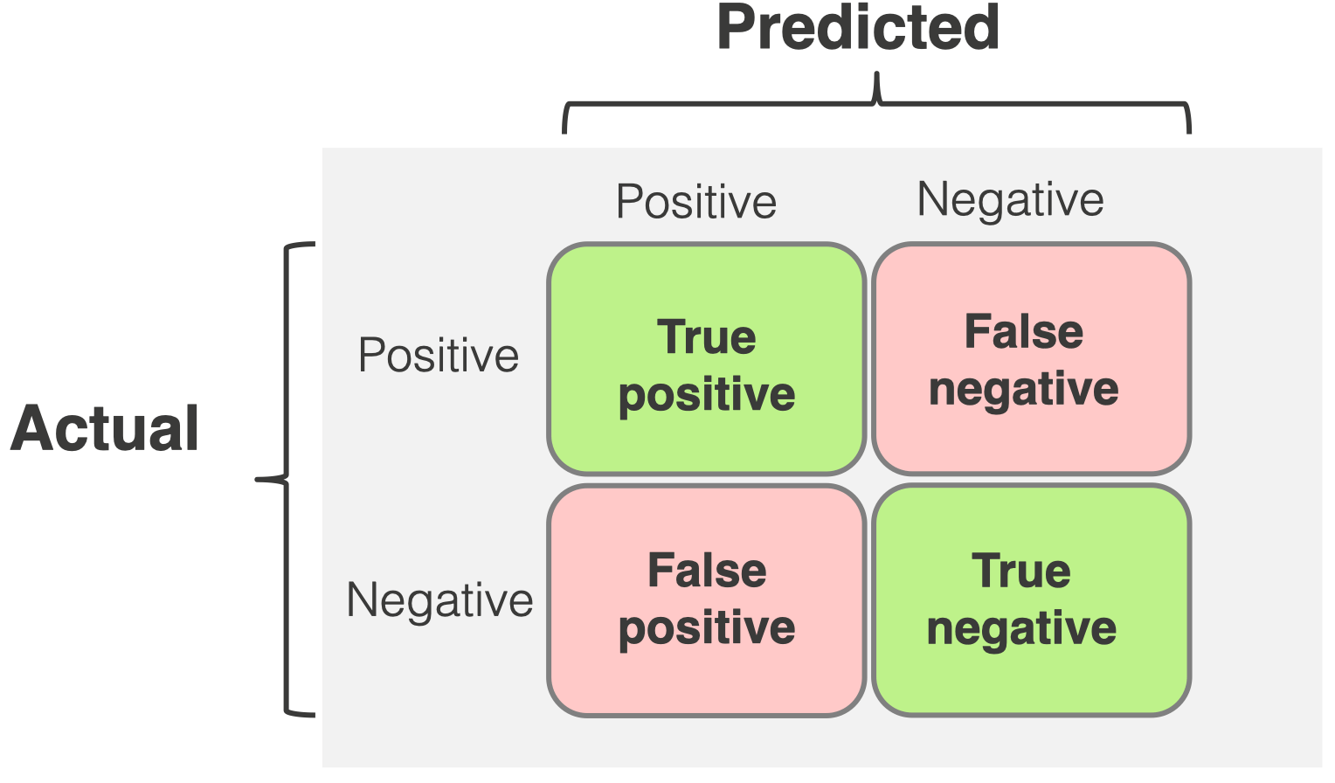
Confusion Matrix
True class
Class A
X | W
Z | Y
The confusion matrix is an n x n matrix (square matrix).
The diagonal entries of the confusion matrix are the rates of correctly classified, while the off-diagonal entries correspond to misclassified
Predicated class
Class B
Class A
Class B
alternative representation

Slide 16
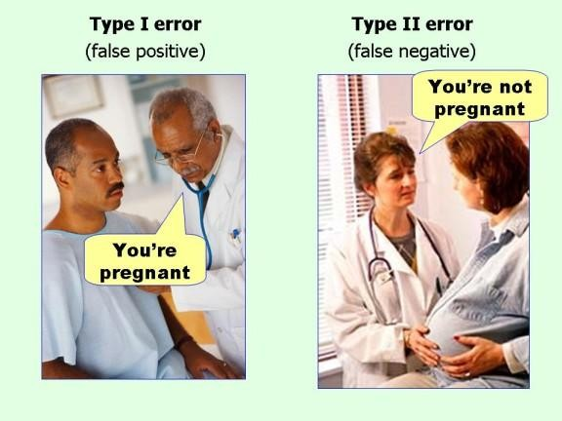
FP & FN

